Slide 1
Employee Data Analysis using Excel
STUDENT NAME: R. Akalya
REGISTER NO: Ammu2005*/asunm110312201084
DEPARTMENT: B.com (accounting and finance)
COLLEGE: DRBCCC Hindu college

Slide 2
PROJECT TITLE
Employee Performance Analysis using Excel

Slide 3


AGENDA
Problem Statement
Project Overview
End Users
Our Solution and Proposition
Dataset Description
Modelling Approach
Results and Discussion
Conclusion
3/21/2024 Annual Review

Slide 4

PROBLEM STATEMENT
1. In this project , we are analyzing employee performance using
excel to track the working skills of the employees in their job
role.
2. We can motivate the employees whose performace level are
low .
3. We can give rewards to employees whose performace level are
high and very high to improve their current performance.
4. We can track the contribution made by the employees towards
the growth and development of the business

Slide 5

PROJECT OVERVIEW
1. In this project we are analyzing about the employees and their
performance level using pivot table and graphs in excel
2. This project shows the level of performance of the employees
from different type of business unit in the organnisation
3. The level of performace are categorized into four level are :
1) very high
2) high
3) med
4) low

Slide 6

WHO ARE THE END USERS?
Organisation
2) Employers
3)Managers
4)Employee

Slide 7

OUR SOLUTION AND ITS VALUE PROPOSITION
THE TECHNIQUES USED:
1. Conditional formatting : to highlight missing values
2. Filter : removing the missing exit date
3. Formula : for calculating employee performace
4. Pivot table: summarize the employee performace analysis
5. Graph chart and pie chart : Data Visualization

Slide 8
Dataset Description
1. We took the employee dataset which is given for project . The
dataset contains 26 features . But we used only 9 features in it
2. All the 9 features are the following:
emp id- num
first name- text
emp type- full time , part time, contract
performace level- high,low,med,very high
gender- women, men
business unit- text
emp rating- numeric
preformace scores- text
emp status- text

Slide 9

THE "WOW" IN OUR SOLUTION
We used particular formula for finding the performance
level of employee
The formula is :
=IFS(Z8>=5,"VERY HIGH",Z8>=4,"HIGH",Z8>=3,"MED",TRUE,"LOW")
3/21/2024 Annual Review
9

Slide 10
MODELLING
DATA COLLECTION:
1)The data is taken from edunet foundation dash board.
2) the dataset contains the employee details
3) the dataset contains 26 features of the employees
FEATURE COLLECTION:
1)We took 9 features out of the 26 features in the dataset
2) Those features are empid , first name, last name,
business unit,emp type, emp status, gender, emp
performance scores, emp ranking
3) These features are used in employee performace analysis
for tracking the working skills of employees
10

Slide 11
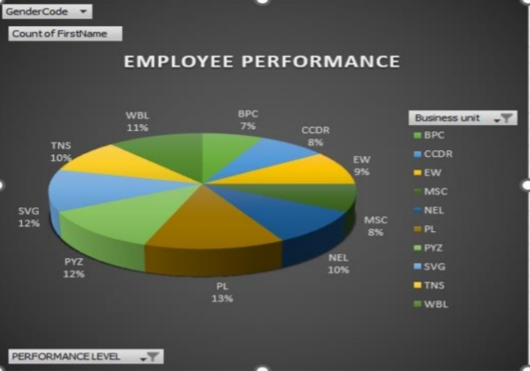
RESULTS
11

Slide 12
conclusion
In the analysis, we found employee performance level from various
business unit in the organisation . In that we found the performance of
the PL unit is 13% which is highest performance and following by PYZ ,
SVG is 12% . The employees from these business unit are performing
well than other units in the organisation.
We used the pivot table for summarizing the performance of each
unit and found the best performing business unit. We used the bar graph
and pie chart for data visualization which helped us in understanding well
about the situation. The best performed business unit employees will get
rewards and incentives to motivate them for working hard

